Slide 1
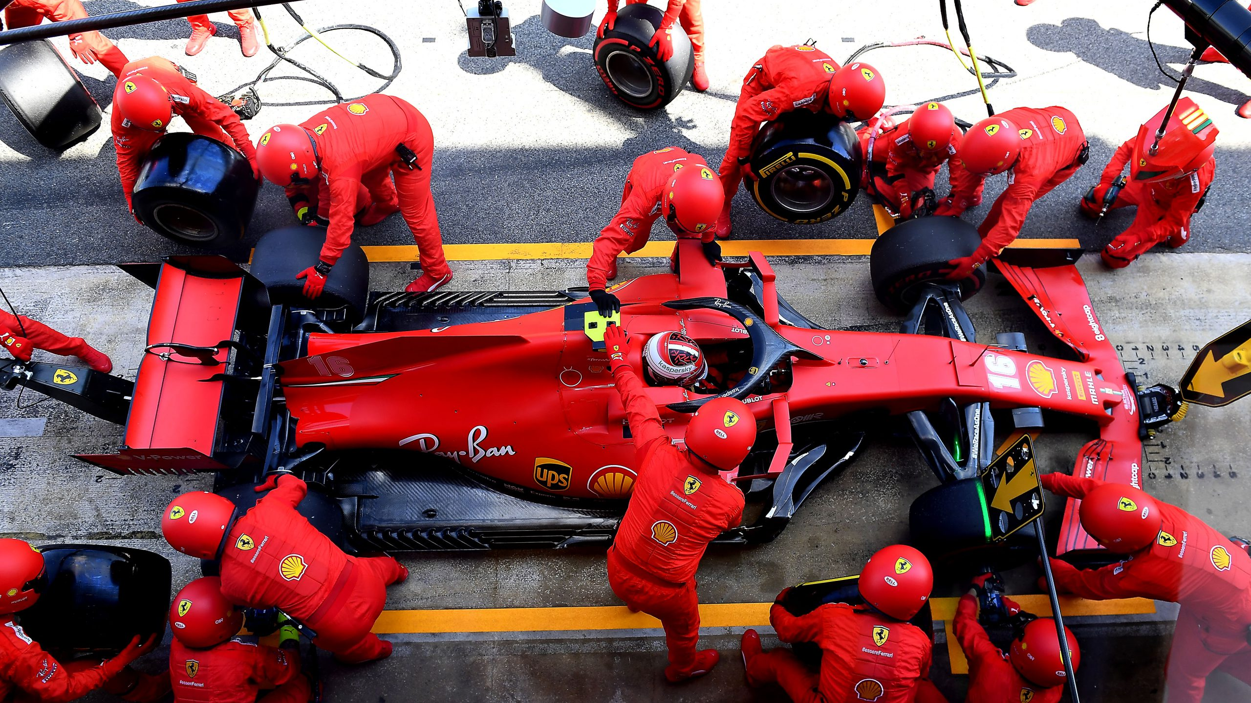
F1 Pit-stop strategy Final presentation
A Big Data Analytics project initiative
on Formula One Racing
Notes:
Good afternoon, Professor Choi, Professor Lam. Welcome to the final presentation of my FYP project on F1 Pit-Stop Strategy.
To start with today’s presentation, let me pick up where we left off from the previous presentation, so to refresh our memories about the project.
Also, I added a page number at the bottom right so you may kindly reference it during the Q&A session.

Slide 2
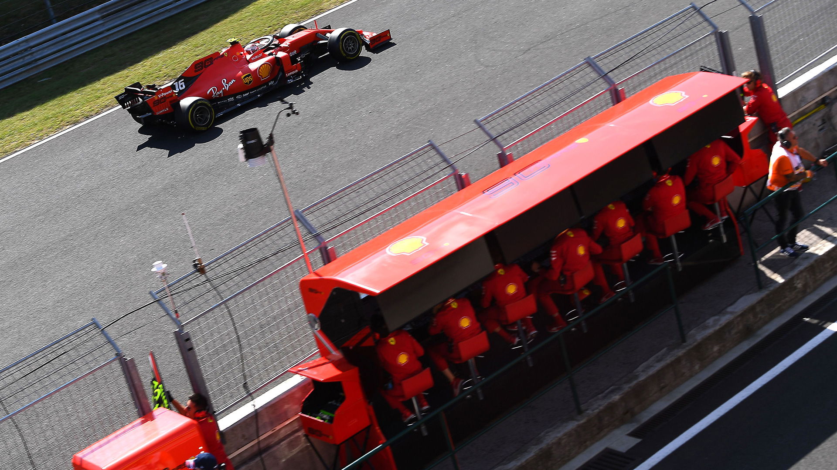
Table of content
General background
Goals
Model 1: Predict Final Position gain or loss
Model 2: Predict Pitstop Strategy under Safety Car Condition
Decision Support System (DSS)
Conclusion
Additional Details

Slide 3
General Background

Slide 4
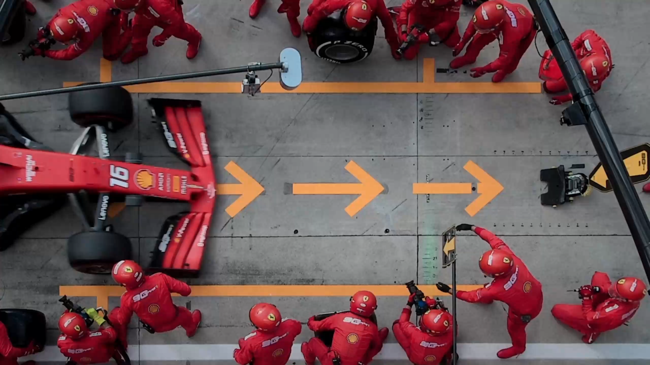
What?... Is Formula One What?... Is Pit-Stop Strategy
30 seconds lost in a pitstop
When to go for a pitstop?
How many times?
How about Accident Scenario?
Notes:
A quick review of what Formula 1 and Pitstop strategy is: Formula One is the topmost motorsport racing event. Pitstop is required in the rules, and is to let drivers switch out worn tyres and put on new fresh tyres. A pitstop would look like this.
(plays video), (click one more time)
It took around 2.5 seconds to change tyres, but in total around 30 seconds travelling in the pitlane. Such a time-consuming activity must be conducted at least once per race. The crucial questions are: When to do a pitstop? How many pitstop is needed? And How about pitstop strategies during the Accident Scenario?

Slide 5
Goals

Slide 6
Goals accomplished
Main objectives
A model that predicts final position (or position change) on a specified set of conditions
A model that suggests the optimal pitstop strategy under the accident scenario with safety car deployed
Side objectives
Create a simplified Decision Support System (DSS) interface that facilitate the access of prediction results
Notes:
The 3 project goals includes, 1) to predict the final position of any driver when given a specified set of conditions. 2) to analyze the optimal pitstop strategy under the Accident Scenario, where the Safety Car is deployed, and 3) a simplified Decision Support System to let user access the prediction results easily.

Slide 7
Model 1: predict final position gain or loss

Slide 8
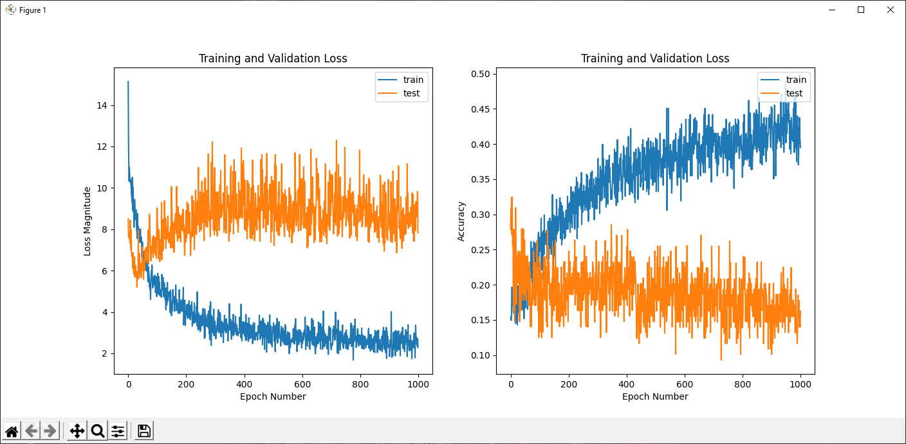
Version 2: 8-layer DNN (from the previous presentation)
Characteristics:
10 input columns
70/30 split of training/validation
Predict final position gain/loss
Problem:
Overfitting occurs
Solution:
Simplify model
Normalization layer & Regularizer
Dropout layers
Horizontal dataset expansion
Vertical dataset expansion
Loss and accuracy for training & testing data from 2017-2019
Notes:
For our first model, where we predict the final position gain or loss, we stopped at the 2nd version from the last presentation. It has 10 input columns, and it predicts the final position gain or loss. From the training and validation curves, we can easily spot out the overfitting problem. Last time we adopted several strategies to solve this problem, such as simplifying the model, adding a normalization layer and regularizers, dropout layers and expand our dataset both horizontally and vertically.

Slide 9
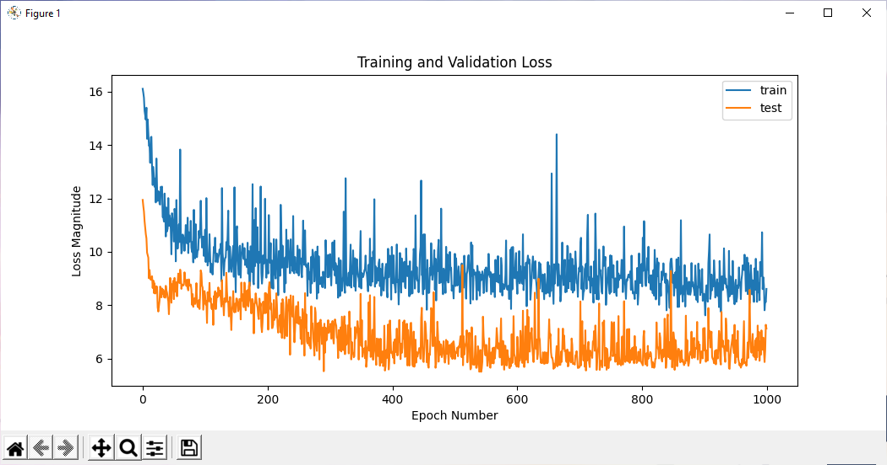
Version 3: Improved overfitting, but imbalance in dataset result label
Characteristics:
12 input columns
Reduced neurons
Normalization preprocessing layer
L2 regularizer at each Dense layer
Dropout layer in between each layer
Add data from 2014-2017
Add a column of driver-related index
Add a column of car-related index
Problem:
Validation loss less than training loss
Loss and accuracy for training & testing data from 2017-2019
Notes:
Version 3 adopted the strategies that we just mentioned. We expand the dataset horizontally by including data from 2014-2017, rather than just 2018 and 2019. We also vertically expand the dataset by including 2 index scores describing driver’s ability and team’s ability.
We can see that the training and validation loss is lower than before. The overfitting problem is seemingly solved, but the validation loss is surprisingly lower than the training loss for every epoch.

Slide 10
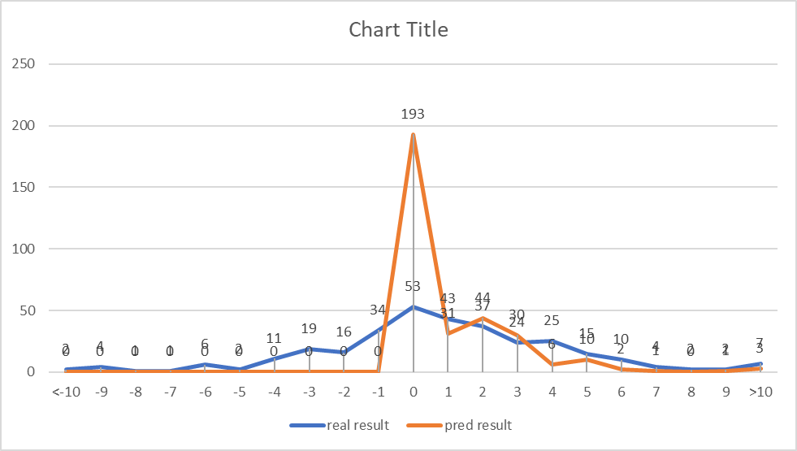
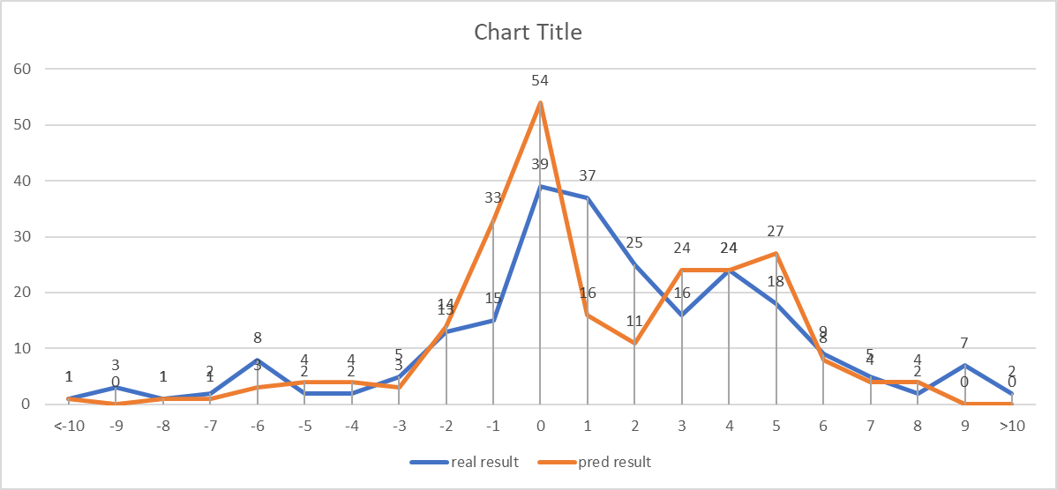
Version 3: Improved overfitting, but imbalance in dataset result label
Imbalance of result label:
Consists of mainly zeroes as result label
Few data rows from -2 to -10, and +4 to +10
Solution:
Switch result label to a flatly-distributed column
2016-2019
2017-2019
Notes:
We try to find out the reason causing such a situation. After some investigation, we find out that there is an imbalance of result label, which is “final position gain or loss”. The dataset consists of mainly zeroes, but so few rows at other positional changes. Therefore, we need to switch to a more flatly-distributed result label to see possible improvement.

Slide 11
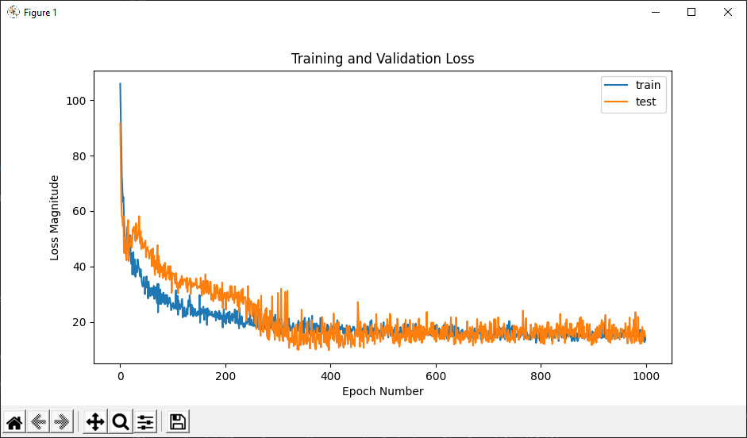
Version 4: Balanced dataset, using “final position” as result label
Characteristics:
“Final position” as result label
Training & Validation loss is close to each other
Both loss is contained at <20, which means ~±4.47 absolute error
MSE Loss of training and validation data
Notes:
In version 4, we switched over to using “final position” as the result label. Both training and validation loss is low and close to each other. Since the loss is a squared mean, the model is having around 4.47 absolute error. This gives a strong indication that a balance dataset is crucial to a model’s accuracy.

Slide 12
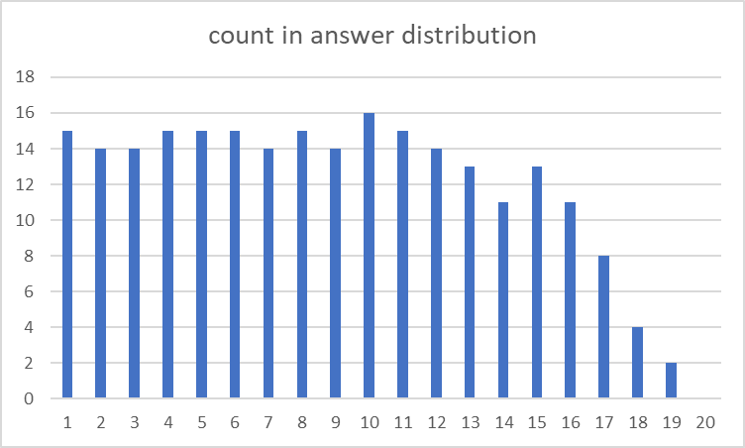
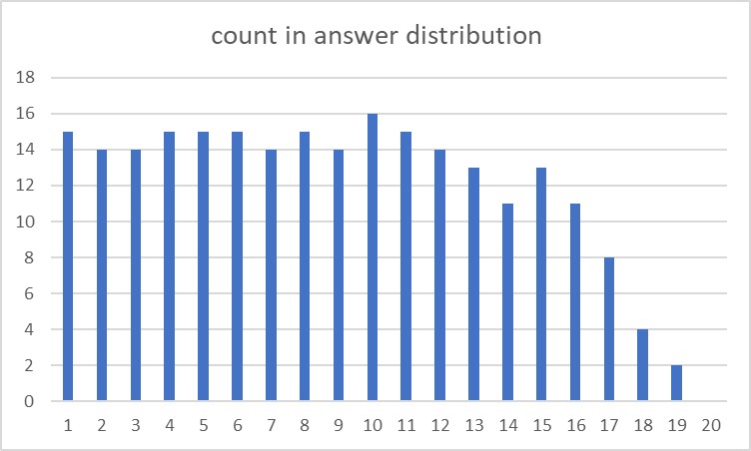
Version 4: Balanced dataset, using “final position” as result label
Characteristics of dataset:
Flat distribution of the “final position” result label
Because a race must have different ending positions
Minor difference in frequencies is due to DNF, or 3-stop strategies, which are excluded
Almost in all races, not all 20 drivers can finish a race, causing the frequency of last positions (P17 - P20) less than others
Distribution of result label “final position” in 2019 races
Distribution of result label “final position” in 2020 races
Notes:
The reason why we chose “final position” as the result label, is because a race must have distinct final positions from P1 to P20, if there is no retirement. (We call position 1 as P1). There are certain records that the model discards, such as DNF records, 3-stop strategies, and so on, making the distribution not exactly flat, but it is good enough.

Slide 13
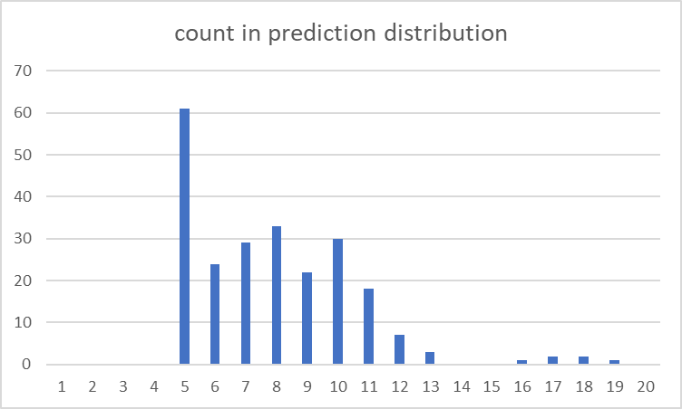
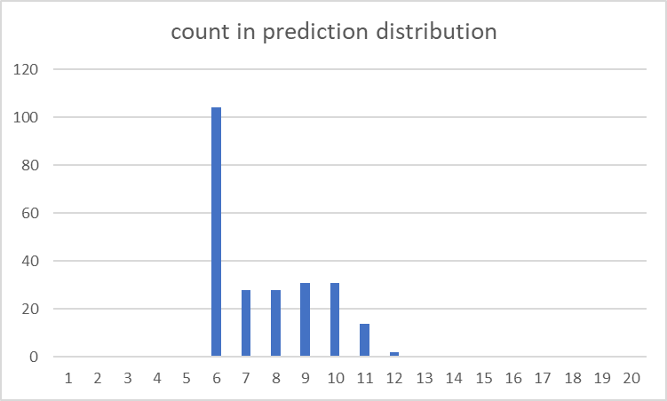
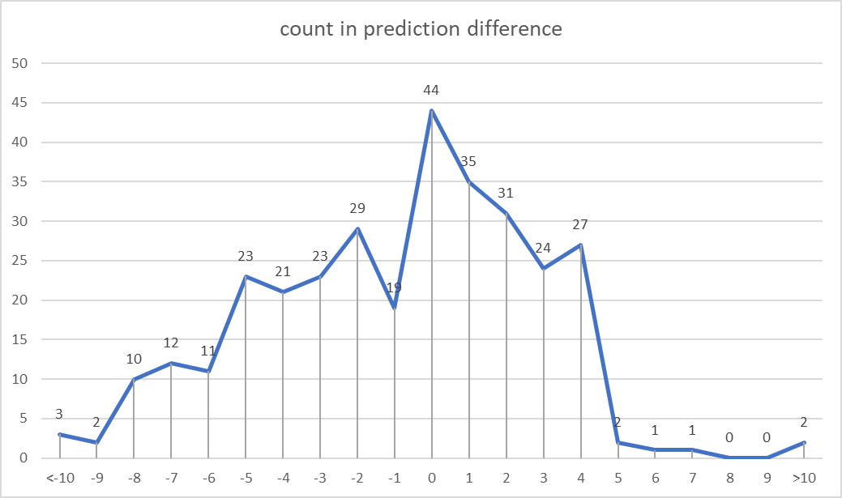
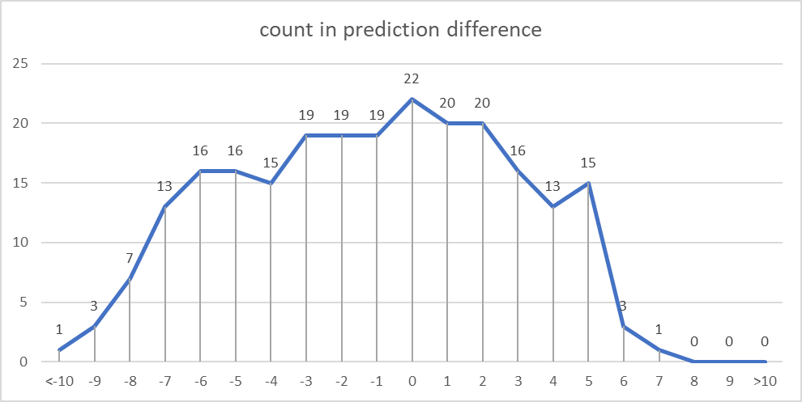
Version 4: Balanced dataset, using “final position” as result label
Problem:
Prediction focused on P5 - P11
Poor accuracy, huge answer-prediction difference (0 means correct prediction)
Solution:
Switch to a new result label
Prediction results in 2019 races
Prediction results in 2020 races
Answer-prediction difference in 2019 races
Answer-prediction difference in 2020 races
Notes:
However, when we look at the prediction results during the testing stage, in both 2019 and 2020, the model only predicts P5-P11. It proves that the model is trying to predict an average position so to reduce the total loss in the loss function. The result we have is therefore just a false hope. We have to try another result label.

Slide 14
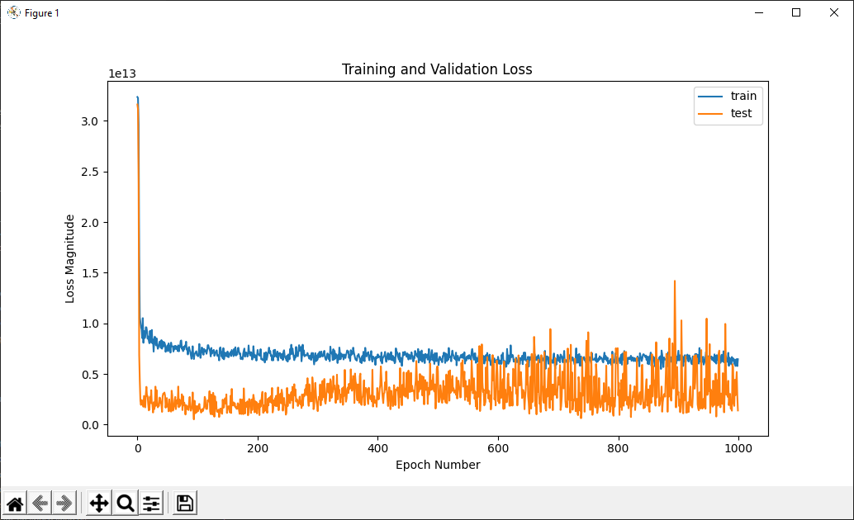
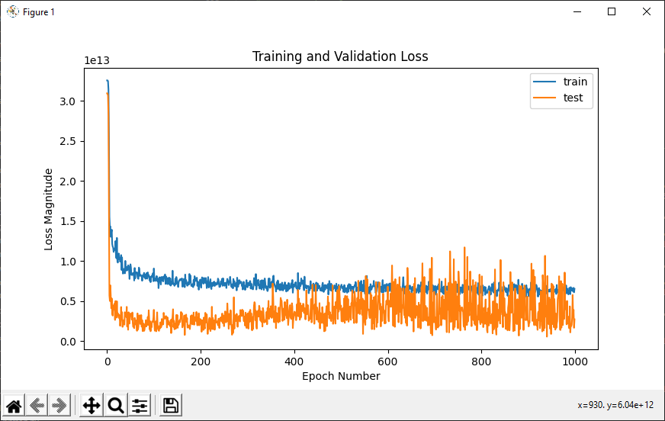
Version 5: “Total race time” as result label
Characteristics:
Validation loss is 21.72 minutes in 2016-2020; and 31.07 minutes in 2017-2020
Validation loss fluctuates and are always lower than training loss
Unacceptably large loss
MSE Loss of training and validation data, 2016-2020
MSE Loss of training and validation data, 2017-2020
Notes:
Version 5 tries using “total race time” as the result label. We tried using “time” because it should be distinct and have a relatively larger difference between each driver. However, the validation loss is 21.72 minutes, and 31.07 minutes respectively in two training sets from 2016-2020 and from 2017-2020. The loss is too huge and prediction is far from accurate.

Slide 15
Version 5: “Total race time” as result label
Technique in arriving prediction result:
Sort all “total race time” predictions result in the same race
Give each sorted row index 1 – 20
Compared with the real final position result label
Findings:
Based on a model trained with 2017-2019 dataset
Total mismatch in predictions and result labels
Sorted “total time” for predicting “final position”, Abu Dhabi 2019
Notes:
If we try to sort all predicted time in the same race, and get the rank number of each driver’s predicted total time, say from index 1 to 20, we can compare it with the real final position of each driver. However, we find out that the model has a total mismatch in predicted position and the result labels.

Slide 16
Version 6: Sorted “final position gain” as result label
Characteristics:
Applying the knowledge of “sorting” prediction results in the same race
Revisit model 3
Model 3 training and validation loss
Notes:
If there is one thing we learnt from version 5, it is the technique to sort the predicted results and transform them to final position in the same race. In version 6, we apply the technique of sorting results, by revisiting model 3.

Slide 17
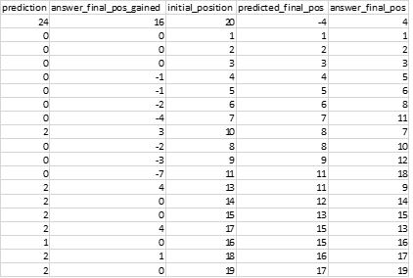
Version 6: Sorted “final position gain” as result label
Calculated final position
Characteristics:
Relatively accurate results
Use “initial position” to minus the predicted final position gain/loss, to arrive a “calculated final position”
Rank the “calculated final position”
Compare with the real final position record
It is relatively accurate!
Problem:
Always predict 0 because of imbalance dataset
Only works well in 0 and extreme cases
Prediction & answer of final position, Abu Dhabi 2019
Notes:
We first predict each driver’s final position gain or loss, and then use “initial position” to minus the predicted “position gain”, so to arrive at the “calculated final position”. Then, we rank the “calculated final position” to compare it with the real final position.
The result shows that it is relatively accurate in prediction! But at the same time, we can see that the predictions always predict 0 or extreme numbers, due to the imbalance dataset problem that remains unsolved in version 3.

Slide 18

Version 7 (Final version): Sorted “final position gain” with adjusted dataset distribution
Objective 1: Optimize training/validation split ratio
Objective 2: Remove rows with high frequencies to flatten the dataset result label
Modification:
MSE to MAE for easier evaluation of results
Notes:
At our final version, we find ways to solve the imbalance dataset problem. The first objective is to optimize training and validation split ratio, and the second objective is to remove rows with high frequencies so to flatten the dataset result label.

Slide 19
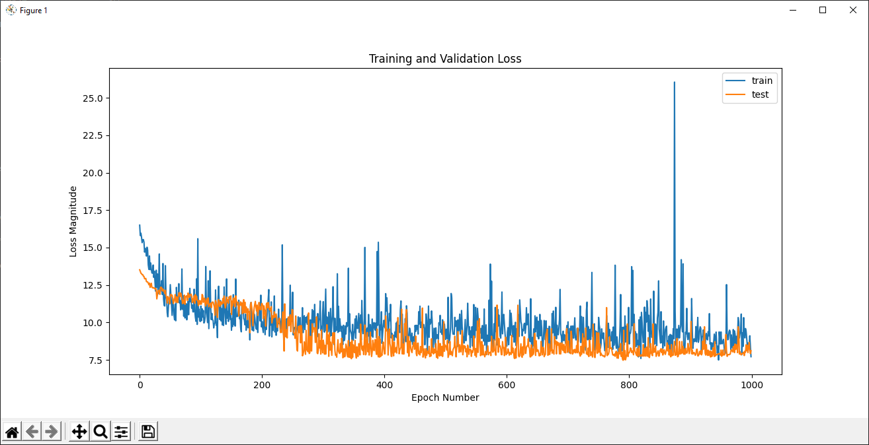
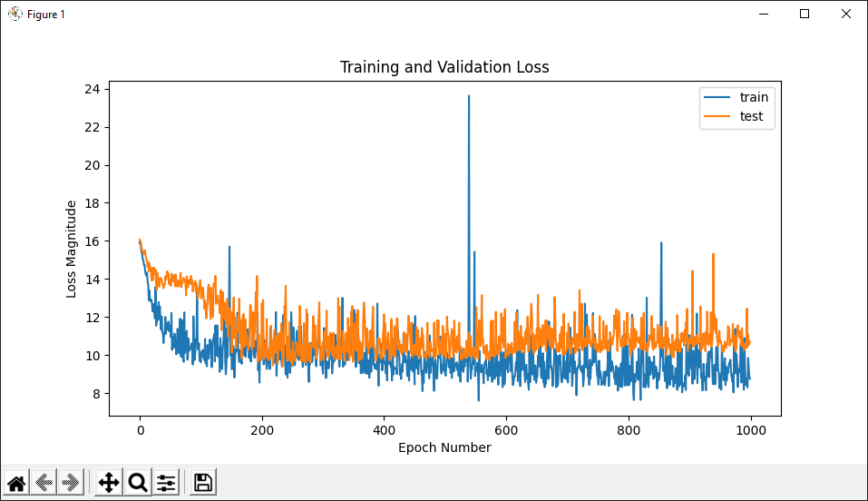
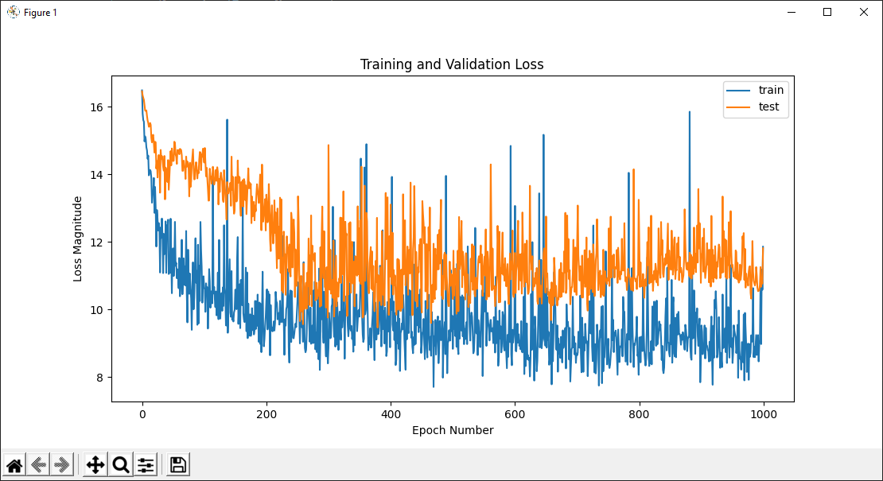
Version 7 (Final version): Sorted “final position gain” with adjusted dataset distribution
70/30, 80/20, 90/10 split on Abu Dhabi 2019:
Loss: 10.69, 9.67, 10.29
Notes:
(Jump to next page) After running several tests on different races, among the 3 options of 70/30, 80/20, and 90/10 split, we conclude that 80/20 split creates the lowest loss among the 3 options.

Slide 20
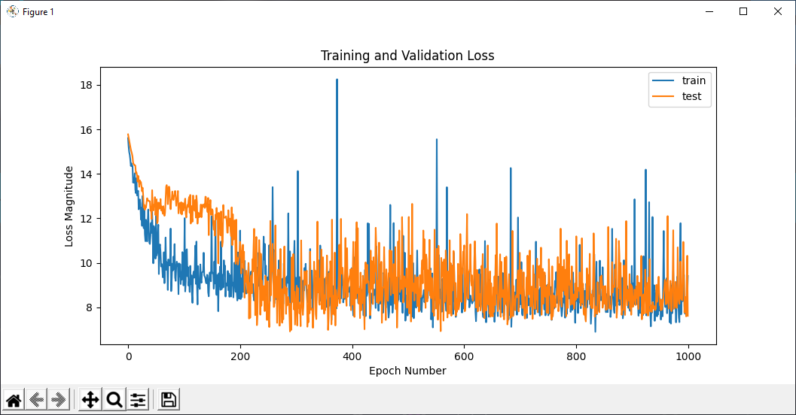
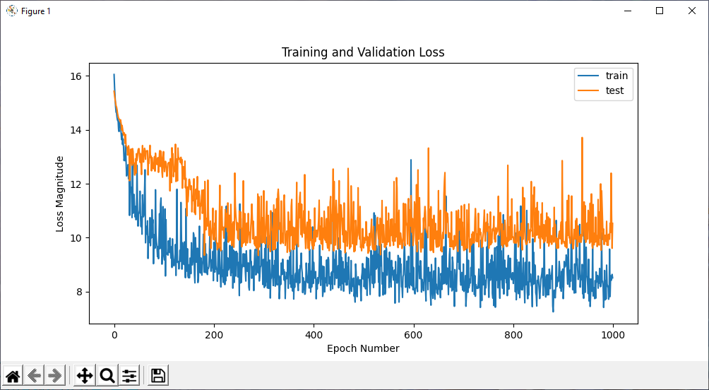
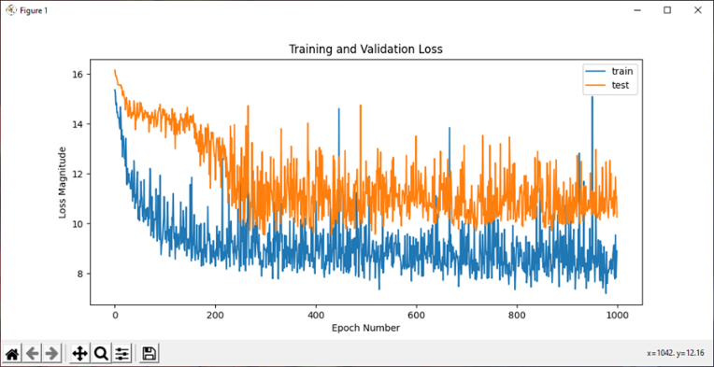
Version 7 (Final version): Sorted “final position gain” with adjusted dataset distribution
70/30, 80/20, 90/10 split on United States 2019:
Loss: 11.36, 9.66, 10.86
Notes:
After running several tests on different races, among the 3 options of 70/30, 80/20, and 90/10 split, we conclude that 80/20 split creates the lowest loss among the 3 options.

Slide 21
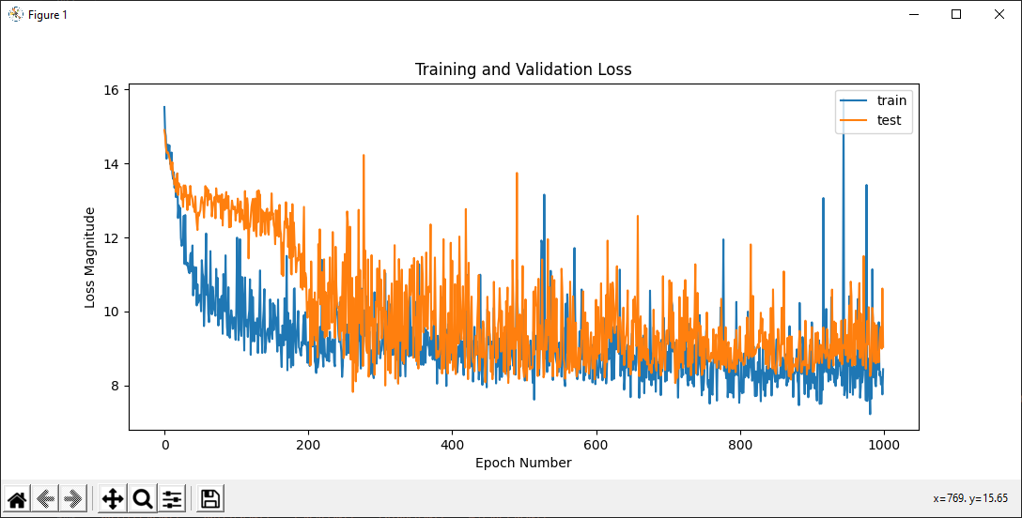
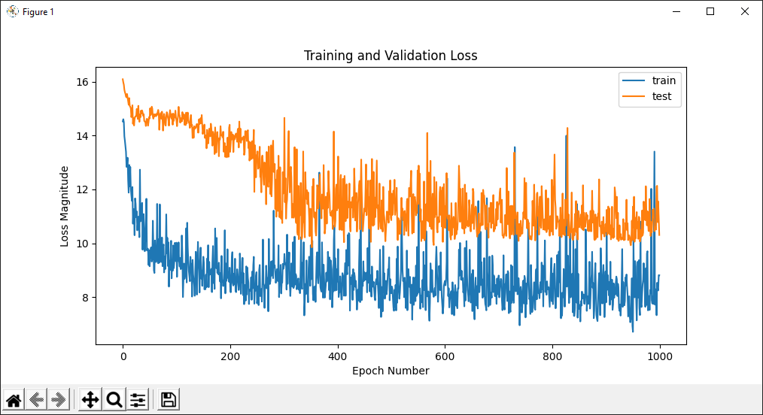
Version 7 (Final version): Sorted “final position gain” with adjusted dataset distribution
80/20 split on Mexican 2019: Loss is 9.34
80/20 split on Japanese 2019: Loss is 9.63
and more testing results…
Conclusion on optimal training/validation split:
80/20 split provides the least loss, hence is the optimal splitting ratio
Notes:
After running several tests on different races, among the 3 options of 70/30, 80/20, and 90/10 split, we conclude that 80/20 split creates the lowest loss among the 3 options.

Slide 22
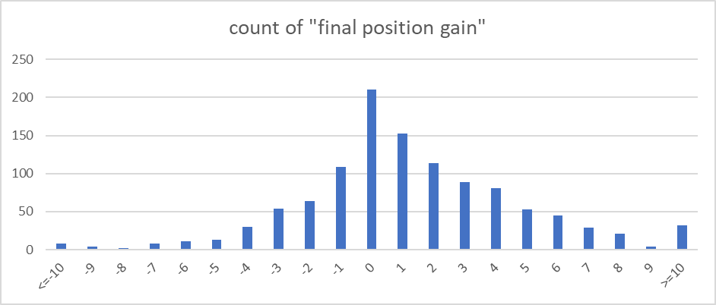
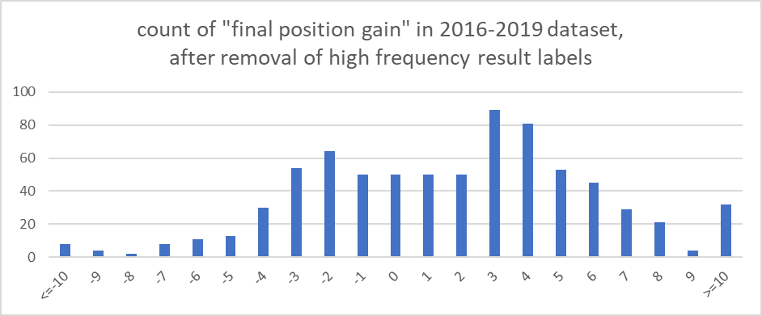
Version 7 (Final version): Sorted “final position gain” with adjusted dataset distribution
Removal of high-frequency result labels:
Select -1, 0, 1, 2 to be the result labels to be partially removed
Use “numpy random.choice” to randomly select different number of rows that make the frequency of labels be 50
The result label would be flattened with similar frequencies from -4 to +6 final position gain/loss
Notes:
Regarding flattening of dataset result label, we select rows with -1, 0, 1 and 2 as result labels, and use “numpy random.choice” to randomly select a specified number of rows from each list of rows to be removed, so their frequency will be 50 rows. We can see that the distribution of result labels is much more flatter than before.

Slide 23
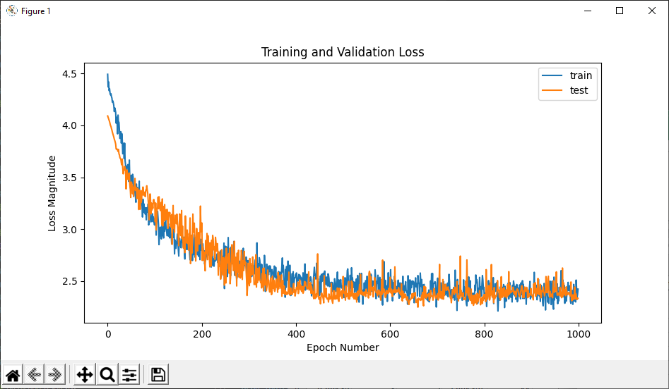
Version 7 (Final version): Sorted “final position gain” with adjusted dataset distribution
Result:
Training/validation loss is very close to each other
The loss is contained at <2.5
Further testing on 2020 season data is required
Loss of training and testing by using “calculated final position”, 2016-2018 seasons.
Notes:
So how would the accuracy be? We ran the same training process and see that both training and validation loss are close to each other, and is contained at <2.5. This gives us strong hope of a well-performing model, but we still need extensive testing work to prove it.

Slide 24
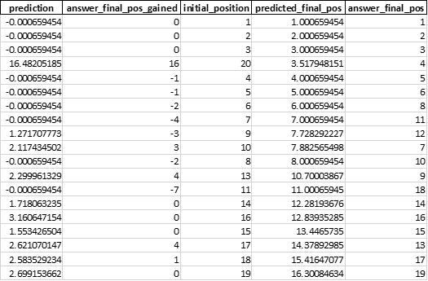
Version 7 (Final version): Sorted “final position gain” with adjusted dataset distribution
Post-processing of “final position gain”
Use “initial position” to minus the predicted final position gain/loss, to arrive a “calculated final position”
Sort the “calculated final position”
Compare against the answer result label, take the absolute difference of them
The average of the absolute difference is our testing “accuracy index”
Notes:
Same as version 6, we arrive at a “calculated final position” and compare it with the real result label. We take the absolute difference between them, and take the average of all records in the same race to form the “accuracy index”, which is in fact the average absolute loss. The lower the “accuracy index”, the more accurate the model performs.

Slide 25











Overview of model 1 architecture
Initial position (starting grid)
Number of pit stops
Number of pit stops under Safety Car
Keras Sequential Model
10 Dense layers
Position, Pitstops & Tyre
# of position gained / lost
Grid/2nd/3rd tyres
Grid/2nd/3rd tyres
distance travelled
Track temperature
Weather
Humidity
Track maximum altitude delta
Track number of turns
Track
Track race distance
Track total length (in km)
Team ability index
Driver ability index
Ability
Notes:
Before going to the evaluation pages, let’s take an overview of the model. We have 17 columns describing the position, pitstop strategies, and tyres, weather condition, track information, and ability index. We fed them to our 10-layer Sequential model, and predict the final position gain or loss.

Slide 26
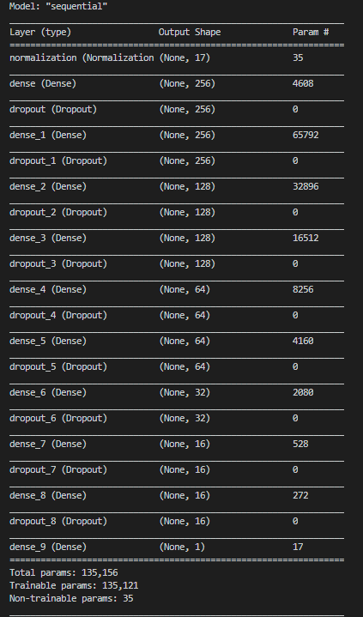
Overview of model 1 architecture
Model architecture:
Normalization layer & L2 regularizers
Dropout layers in between Dense layers
256 to 1 decreasing number of neurons
RMSprop as optimizer
Mean Absolute Error as loss function
SeLU as activation function
Keras Sequential Model
10 Dense layers

Slide 27
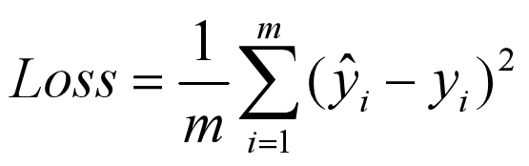
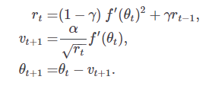
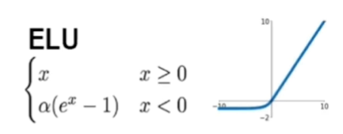
Overview of model 1 architecture
Loss function: Mean Squared Error
Benefits: Insensitive to outliers and errors in data
Mathematically intuitive to adopt for regression
Keras Sequential Model
10 Dense layers
For m rows of data, the sum of the square difference between label and prediction of the i^{th} data
Optimizer: RMSprop
Benefits: Maintain a moving average of the gradients,
And use that average to estimate the variance,
Robust optimizer
f′(θ_{t}): derivative of the loss of parameters at time step t
α: step rate
γ: decay term
Layer activation function: SeLU
Benefits: Preserving the mean & variance of the inputs between consecutive layers under certain conditions*
SELU multiplies scale (>1) with the output of ELU,
so to ensure a slope larger than 1 for positive inputs

Slide 28




Overview of model 1 architecture
Dataset:
17 input columns, 1 output column
1135 records from 2016-2020 seasons
934 records from 2016-2019 seasons
80%
20%
New
Using pandas “sample”
that allows 20% of validation data be randomly chosen for each epoch
Training data
Validation data
Season as testing data
Notes:
Regarding the dataset, we have 1135 record from 2016-2020 season.
To recap, 80% of the dataset is served as training data, while 20% of them is validation data. We take the consecutive year as the testing data. For example, a model trained with 2016-2019 season would use 2020 season as testing dataset. We would also randomly choose validation data from the dataset for each epoch.

Slide 29
Evaluation of model 1
Australia 2019, accuracy index = 2.117647
Abu Dhabi 2019, accuracy index = 1.368421
Austrian 2019, accuracy index = 2.3
Azerbaijan 2019, accuracy index = 1.125
Belgian 2019, accuracy index = 3
Bahrain 2019, accuracy index = 3.578947
Notes:
These are the evaluations.

Slide 30
Evaluation of model 1
Brazilian 2019, accuracy index = 3.75
British 2019, accuracy index = 2
Canada 2019, accuracy index = 1.66667
Chinese 2019, accuracy index = 1.888889
French 2019, accuracy index = 2.210526
Hungarian 2019, accuracy index = 1.894737

Slide 31
Evaluation of model 1
Italian 2019, accuracy index = 2.588235
Japanese 2019, accuracy index = 2
Mexican 2019, accuracy index = 1.777778
Russian 2019, accuracy index = 1.866667
Singapore 2019, accuracy index = 1.882353
Monaco 2019, accuracy index = 2.210526

Slide 32
Evaluation of model 1
Spanish 2019, accuracy index = 1.222222
United States 2019, accuracy index = 2.111111
In the 2019 season, the total average accuracy index is 2.127986
→ Final position prediction would have ±2.127986 error.
Notes:
In the 2019 season, the model has a ±2.13 error in predicting final position.

Slide 33
Evaluation of model 1
70th anniversary 2020, accuracy index = 2.4
Russian 2020, accuracy index = 1.764706
Abu Dhabi 2020, accuracy index = 1.111111
Sakhir 2020, accuracy index = 3.583333
Austrian 2020, accuracy index = 2.307692
Spanish 2020, accuracy index = 1.555556
Bahrain 2020, accuracy index = 3
Styrian 2020, accuracy index = 2.941176
Belgian 2020, accuracy index = 0.941176
Tuscan 2020, accuracy index = 1.666667
British 2020, accuracy index = 2.588235
Eifel 2020, accuracy index = 2
Imola 2020, accuracy index = 2.142857
Italian 2020, accuracy index = 3.625
Portuguese 2020, accuracy index = 1.789474
In the 2020 season, the total average accuracy index is 2.227799
→ Final position prediction would have ±2.227799 error.
Notes:
While in the 2020 season, the model has a ±2.23 error in predicting final position. Here we simplified the display of evaluation process, but it is the same.

Slide 34
Conclusion of model 1
Challenges:
“Corona calendar” in 2020 season
5 new tracks with no prior race information/car testing experience
As opposed to decades of same tracks from 2014-2019
Performance:
Generalization of track characteristics is proven to be effective in prediction
Around ±2.2 error from final position
Proven to be accurate, reliable, and useful for future use of Scuderia Ferrari F1 Team
Notes:
We can conclude that model 1 is accurate and reliable, even though we have a new “corona race schedule” with 5 new, unknown tracks, the generalization technique in how we generalize the tracks help us in giving out high accuracy prediction in final position.

Slide 35
Model 2: predict pitstop strategy under safety car condition
Notes:
For our 2nd model, we predict pitstop strategy under the safety car condition.

Slide 36
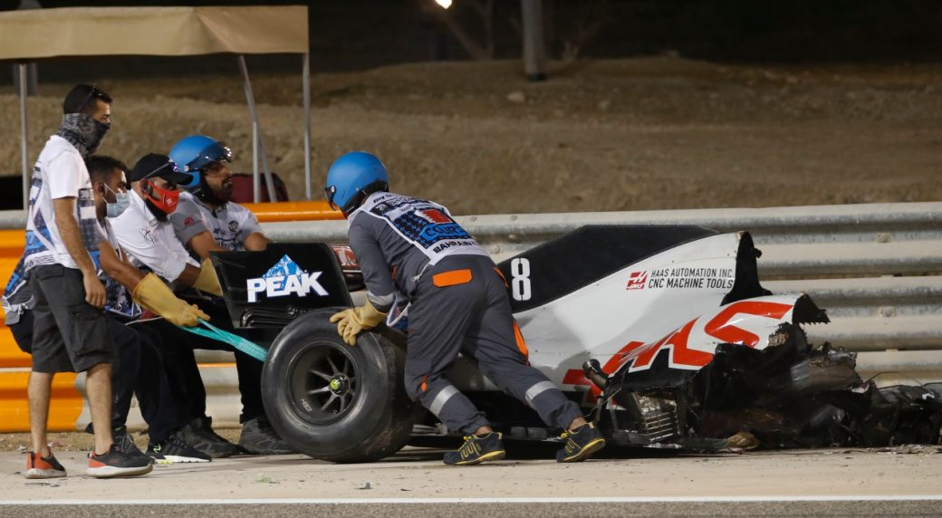
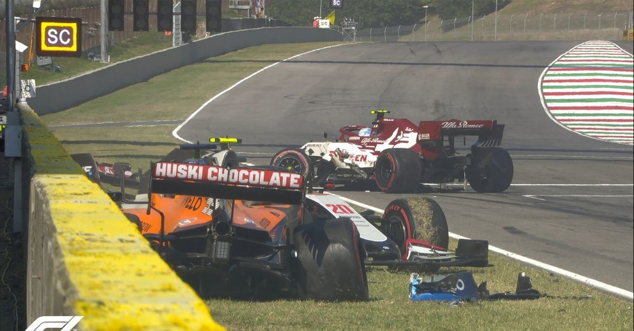
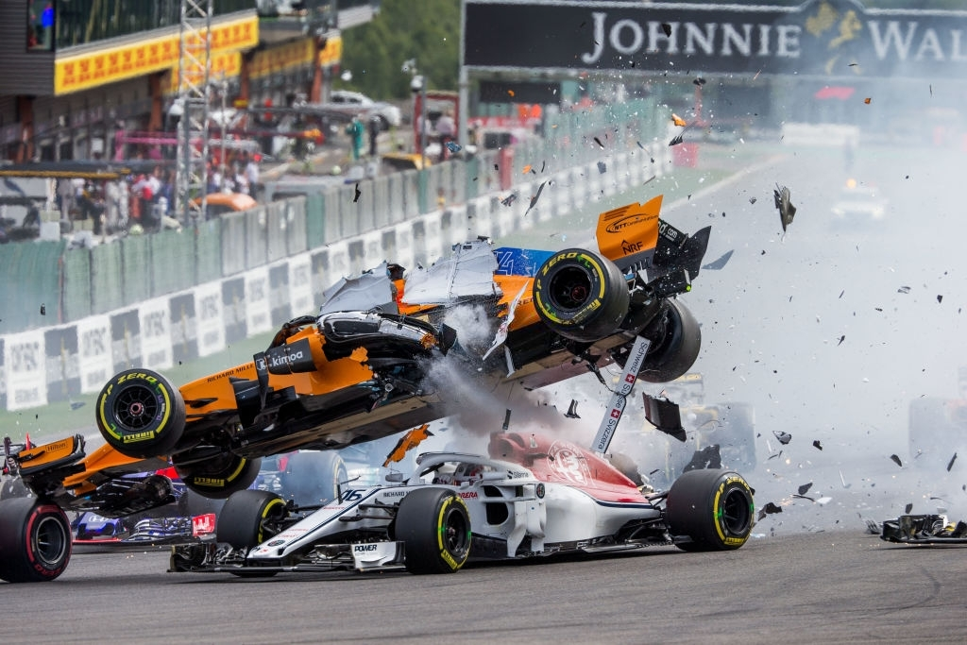
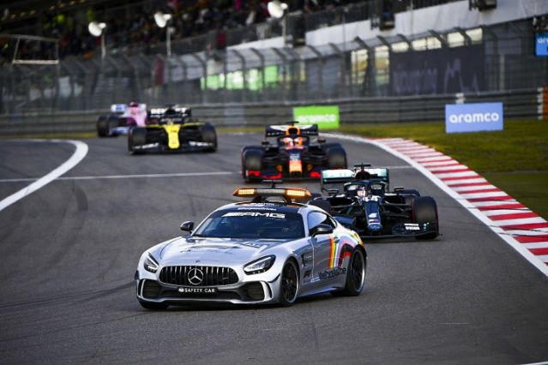
What is an Accident Scenario?
Car crashing to wall
Car crashing to another car
Engine failure, brake failure, suspension system failure, out of gas
Notes:
An accident scenario means there is a hazard on the track caused by car crashing or car failure.

Slide 37
What is a Safety Car condition?
Retired car stop on the track
Marshall (Track staff member) needs to clear the track from obstacles
A “Safety Car” is deployed to limit all cars’ travelling speed
Notes:
A safety car condition means a safety car is deployed to limit all car’s travelling speed, so to let the Marshall clear up the track from obstacles.

Slide 38
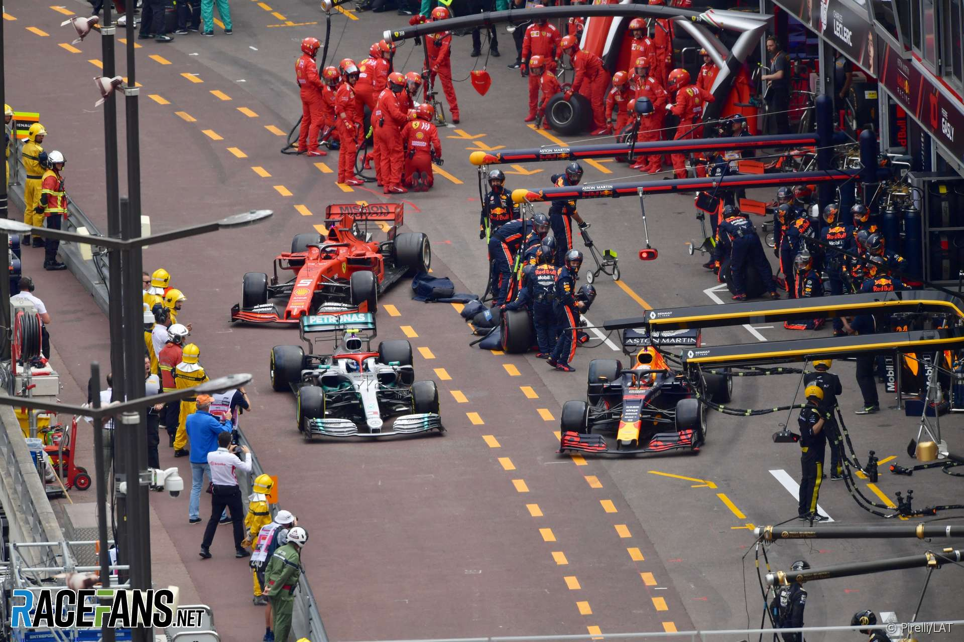
What and why is the strategy in Safety Car condition different?
Cars travel slowly than normal
Time lost in going to pitstop is less than normal
Lose less position when rejoining the race
Analogy to help understanding:
You promise to bake a cake for your Mom, who is driving home
Mom normally drives home in 10 minutes
Baking a cake takes 20 minutes
Because of traffic jam, it takes 30 minutes to drive home
Mom enjoys the cake when she comes back
Traffic jam is like the Safety Car condition
Baking cake is like going for a pitstop
Notes:
To understand why the strategy during Safety Car condition is crucial to a race win, there is an analogy: You promise Mom to bake a cake. Mom normally drives home in 10 minutes, while baking a cake takes 20 minutes. However, Mom told you that because of a traffic jam, she is taking 30 minutes to drive home. That’s why Mom can enjoy the cake when she comes back.
The traffic jam is like a safety car condition, where all cars outside drives slower than normal; While baking a cake is like going for a pitstop, such that the time lost in the pitstop is less than normal under such conditions.

Slide 39

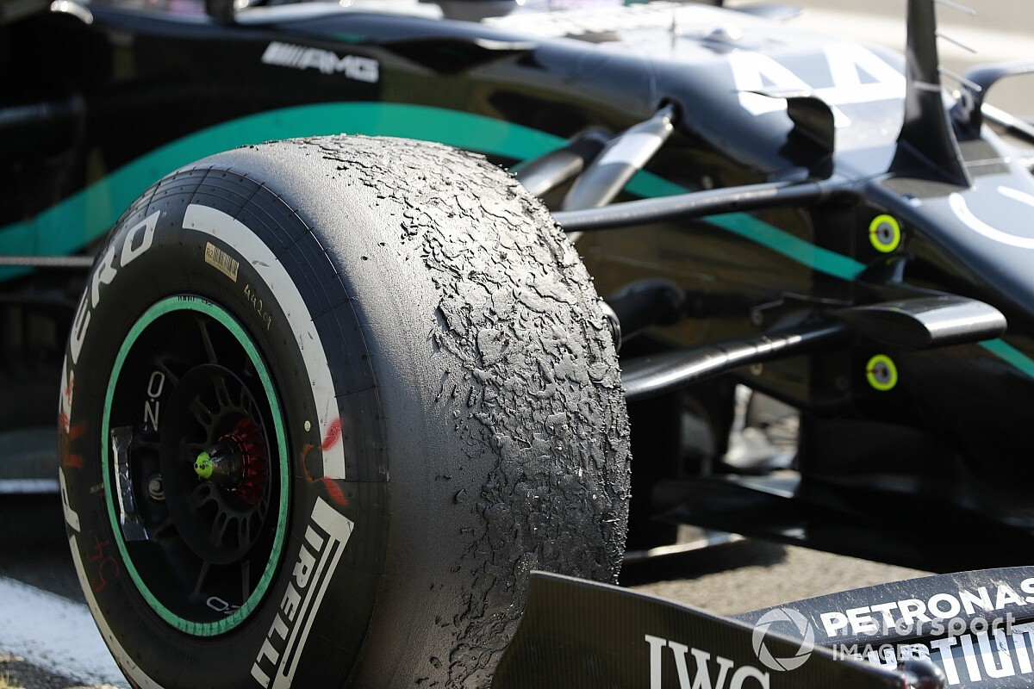
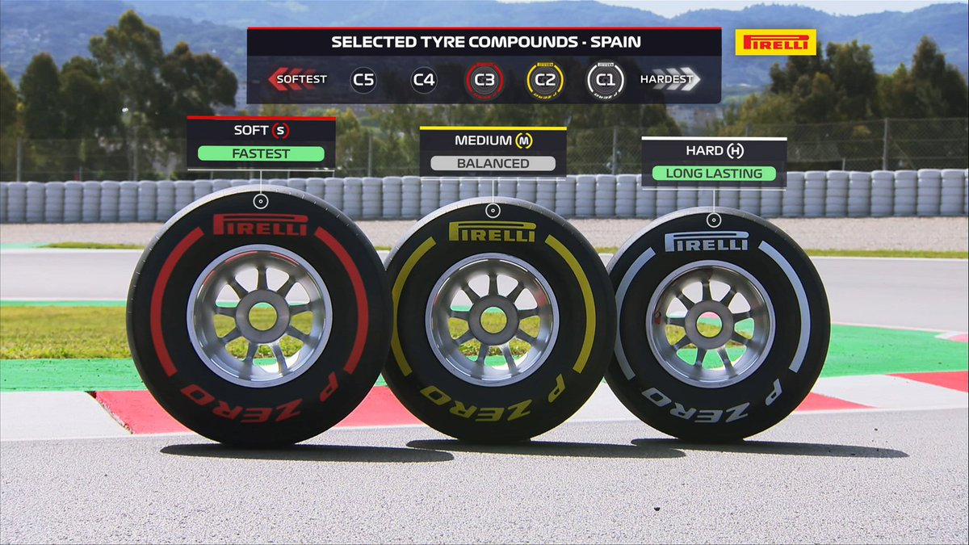
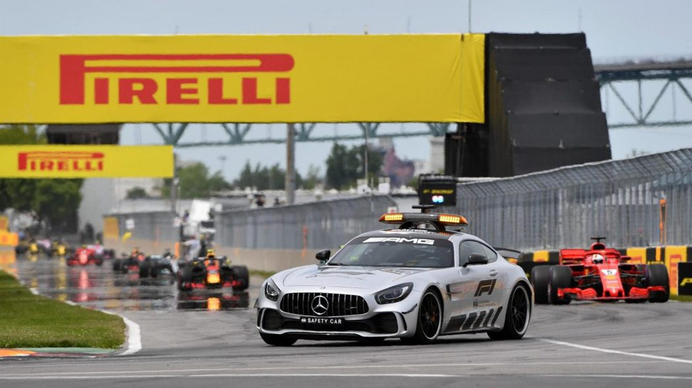
Dilemma of Safety Car condition
Going for a pitstop:
Lose less time than the planned pitstop
Fresher tyres for the remaining race
Reduced risk of tyre failure
Staying out on the track:
Gain positions/at least remain original position
Too little time for the team to react, about which tyre compound to put on
Notes:
The dilemma of pitting in during the safety car is that, if we go for a pitstop, we lose less time than the planned pitstop, and to enjoy a fresher set of tyres. But if we stay out, we can gain positions from people going to pit, or at least remain the original position.

Slide 40
Version 1: Reuse model 1 with slight changes to input fields
Characteristics:
Reusing model 1
Delete several columns that should be “unknown” by the time Accident occurs
Problems:
Sc = 1 can be from the first safety car occasion, or the second
Cannot represent multiple safety car scenario
Dataset right after the first accident by No. 16 Charles Leclerc, Monaco 2019
Notes:
Our first version tries to reuse model 1, and remove the data columns that is logically unknown when the accident occurs in the middle of the race. However, the data columns cannot represent multiple safety car scenario, which is inaccurate in representation.

Slide 41
Preprocessing of Dataset (partial)
Dataset preprocessing:
Each Safety Car condition is treated as a separate record
A race with 2 Safety Car conditions will have a duplicated record for each driver, describing the 2 separate Safety Car events
Brazil 2019, showing duplicated racers’ data rows
Notes:
Therefore, we duplicated each driver’s record for each safety car occasion, and treat each safety car event as a separate record. Here we can see that each driver owns 2 separate records, and they have different safety car pitstop decisions for the 2 safety car occasions.

Slide 42
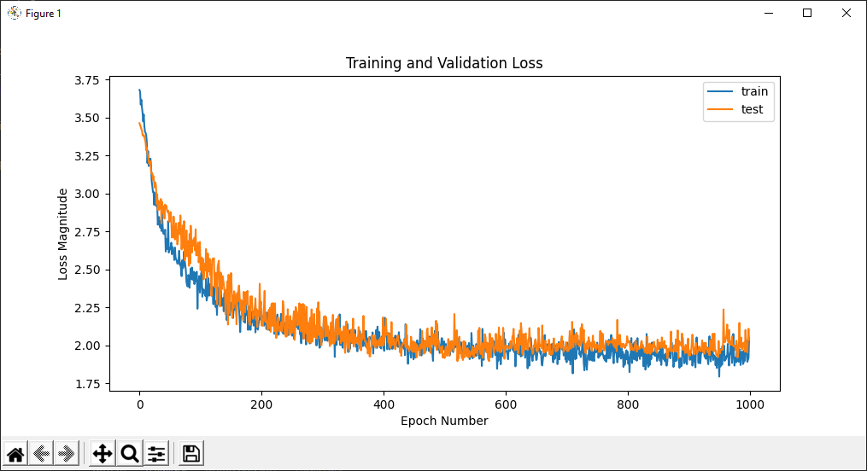
Version 2: New columns, duplicate driver rows for each safety car scenario
Characteristics:
15 input columns
Input columns concern “current state” of the car and the race
Same model architecture as model 1
Loss of training and testing, 2016-2019 seasons
Notes:
Version 2 of the model takes 15 input columns that is mostly derived from the datasets scraped online. They concern about the current state of the car, and the details of the input data will be discussed soon. Our result label, and the model design is same as model 1.

Slide 43
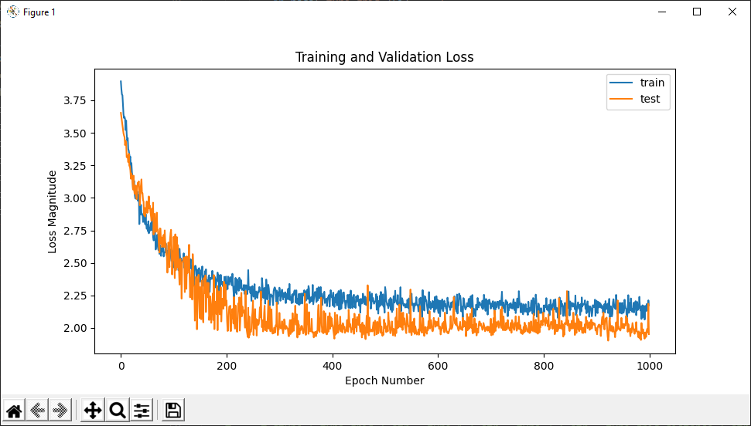
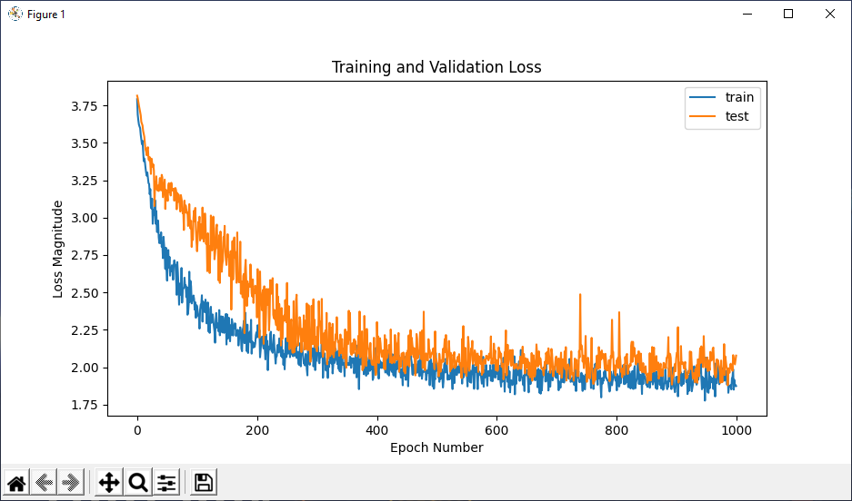
Version 2: New columns, duplicate driver rows for each safety car scenario
Loss of training and testing, 2016-2020 seasons.
Loss of training and testing, 2016-2018 seasons.
Notes:
We can see a decent training and validation loss in both graphs.

Slide 44
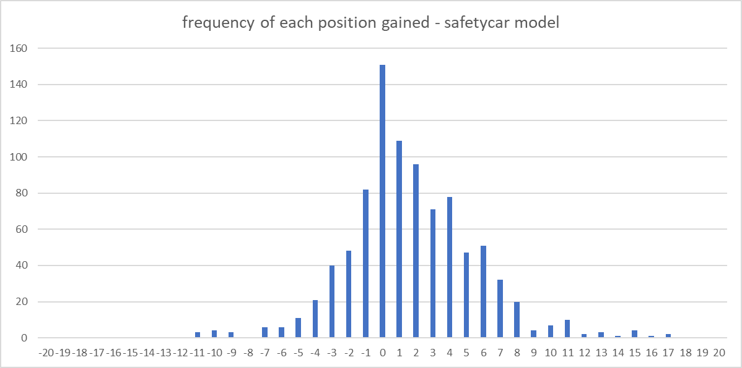
Version 2: New columns, duplicate driver rows for each safety car scenario
Imbalance of result label:
Consists of mainly zeroes as result label
Few data rows from -2 to -10, and +4 to +10
Same situation we met in Model 1: Version 3
Solution:
Crop out high-frequency rows
Frequency distribution of each position gained, 2016-2020 seasons
Notes:
But suspiciously, we check with the imbalance dataset problem, and in this case, the result label is also containing many zeroes. Therefore, we try to crop out high-frequency rows with the previous technique.

Slide 45
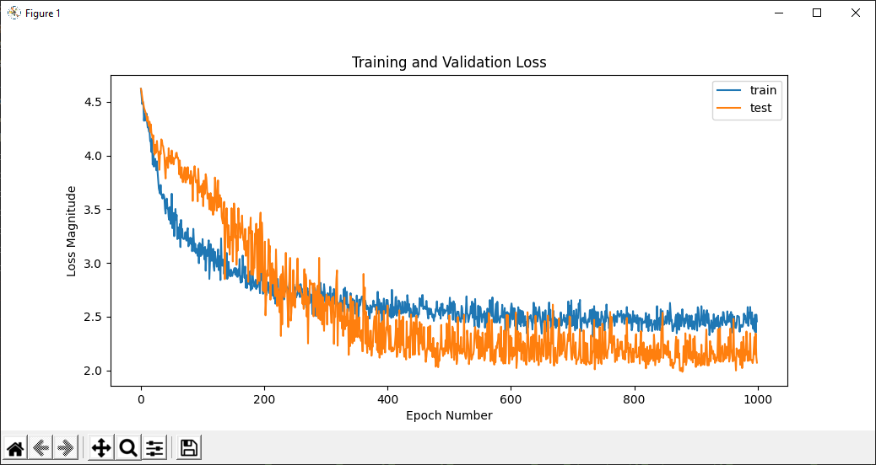
Version 2: New columns, duplicate driver rows for each safety car scenario
Observation:
Performs worse than uncropped model
Solution:
Since this model focuses on the binary decision under safety car condition: 1) pit in, 2)stay out
We should check the distribution of this input column: “pitstop decision under safety car condition”
Loss of training and testing, high frequencies cropped,
2016-2019 seasons
Notes:
However, the model performs worse than that of the uncropped model. Since this model tries to make the binary decision of either going to the pit or staying out during the safety car condition, we check the distribution of this input column as well.

Slide 46
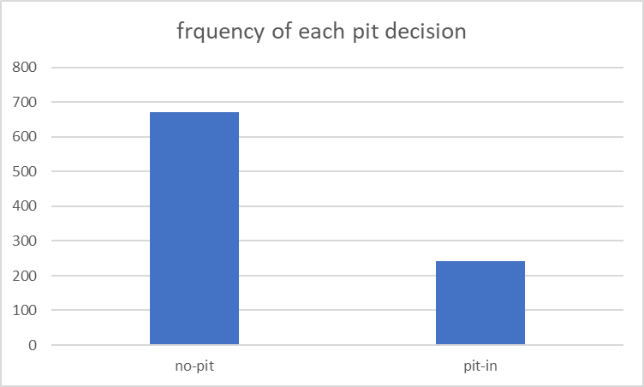
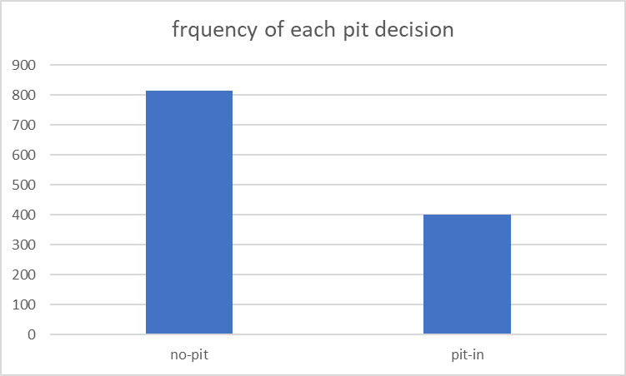
Version 2: New columns, duplicate driver rows for each safety car scenario
2016-2019
2016-2020
Frequency of each pit decision:
671:241 in 2016-2019 seasons
813:401 in 2016-2020 seasons
Observation:
2016-2020 is more “balanced”, about 2:1
2016-2019 is less “balanced”, about 3:1
However, we already know that 2016-2019 has a higher model accuracy/lower MAE loss
Stay with uncropped model
Notes:
Imbalance of no-pit and pit-in also exist. It is around 2 to 1 in 2016-2020, and 3 to 1 in 2016-2019. However, we already know that 2016-2019 has a higher model accuracy, which means making the dataset more balanced on the frequency of pit decision would not help increase the model accuracy. In addition, we decide not to crop the dataset because cropping 400 records from the training dataset could severely affect the training effectiveness of the model. Hence, we decide to stay with the uncropped model.

Slide 47

Overview of model 2 architecture
Initial position
Current position
Lap number of Safety Car
Keras Sequential Model
10 Dense layers
Current tyre compound
Current position,
tyre and decision
# of position gained / lost
Laps travelled
Laps remaining
Decision of going to pit or staying out
Track temperature
Weather
Humidity
Track maximum altitude delta
Track number of turns
Track
Track race distance
Track total length (in km)
Team ability index
Driver ability index
Ability
Notes:
Let’s take an overview of the model 2. We have input data regarding the current position, current tyre compound, how many laps is travelled on it, and how many laps remained in the race, etc. By varying the binary decision of pitting in or staying out, we can generate 2 position gain or loss predictions. Comparing the 2 predictions would mean picking the optimal decision of either pitting in or staying out.

Slide 48
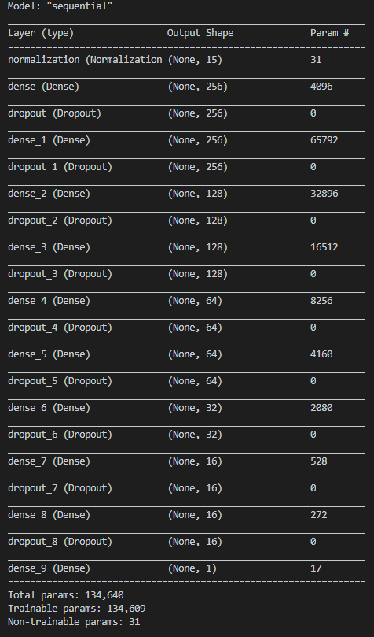
Overview of model 2 architecture
Model architecture:
Normalization layer & L2 regularizers
Dropout layers in between Dense layers
256 to 1 decreasing number of neurons
RMSprop as optimizer
Mean Absolute Error as loss function
SeLU as activation function
Keras Sequential Model
10 Dense layers

Slide 49
Overview of model 2 architecture
initial_pos | sc_lap | sc_decision | sc_laps_travelled | sc_laps_remaining | sc_tyre_compound | before_pit_pos | Temperature | Humidity | Altitude | Turns | RaceDistance | TrackLength | TeamAbility | DriverAbility | final_pos_gained
7 | 1 | 0 | 17 | 55 | 4 | 7 | 66.04 | 0.45 | 7.4 | 16 | 56 | 5.451 | 91 | 54 | 0
15 | 1 | 1 | 1 | 55 | 3 | 20 | 66.04 | 0.45 | 7.4 | 16 | 56 | 5.451 | 145 | 49 | -3
3 | 1 | 0 | 17 | 55 | 3 | 4 | 66.04 | 0.45 | 7.4 | 16 | 56 | 5.451 | 504 | 240 | 0
13 | 1 | 0 | 24 | 55 | 3 | 12 | 66.04 | 0.45 | 7.4 | 16 | 56 | 5.451 | 57 | 43 | 4
10 | 1 | 0 | 7 | 55 | 4 | 10 | 66.04 | 0.45 | 7.4 | 16 | 56 | 5.451 | 0 | 8 | -1
6 | 1 | 0 | 18 | 55 | 4 | 6 | 66.04 | 0.45 | 7.4 | 16 | 56 | 5.451 | 417 | 95 | 0
12 | 1 | 0 | 19 | 55 | 3 | 8 | 66.04 | 0.45 | 7.4 | 16 | 56 | 5.451 | 73 | 52 | 4
4 | 1 | 0 | 21 | 55 | 3 | 3 | 66.04 | 0.45 | 7.4 | 16 | 56 | 5.451 | 504 | 264 | -1
16 | 1 | 0 | 19 | 55 | 3 | 13 | 66.04 | 0.45 | 7.4 | 16 | 56 | 5.451 | 73 | 21 | 4
9 | 1 | 0 | 8 | 55 | 4 | 11 | 66.04 | 0.45 | 7.4 | 16 | 56 | 5.451 | 0 | 20 | -4
20 | 1 | 0 | 18 | 55 | 4 | 18 | 66.04 | 0.45 | 7.4 | 16 | 56 | 5.451 | 85 | 92 | 10
5 | 1 | 0 | 16 | 55 | 3 | 5 | 66.04 | 0.45 | 7.4 | 16 | 56 | 5.451 | 417 | 278 | 1
2 | 1 | 0 | 21 | 55 | 3 | 1 | 66.04 | 0.45 | 7.4 | 16 | 56 | 5.451 | 739 | 413 | 1
14 | 1 | 1 | 1 | 55 | 3 | 19 | 66.04 | 0.45 | 7.4 | 16 | 56 | 5.451 | 145 | 96 | 0
17 | 1 | 0 | 21 | 55 | 3 | 15 | 66.04 | 0.45 | 7.4 | 16 | 56 | 5.451 | 1 | 0 | 1
1 | 1 | 0 | 20 | 55 | 3 | 2 | 66.04 | 0.45 | 7.4 | 16 | 56 | 5.451 | 739 | 326 | -1
18 | 1 | 0 | 25 | 55 | 3 | 16 | 66.04 | 0.45 | 7.4 | 16 | 56 | 5.451 | 1 | 1 | 1
19 | 1 | 0 | 6 | 55 | 4 | 14 | 66.04 | 0.45 | 7.4 | 16 | 56 | 5.451 | 57 | 14 | 4
18 | 1 | 0 | 34 | 55 | 3 | 17 | 90.49 | 0.38 | 10.7 | 21 | 55 | 5.554 | 62 | 12 | 4
5 | 1 | 0 | 32 | 55 | 4 | 6 | 90.49 | 0.38 | 10.7 | 21 | 55 | 5.554 | 419 | 170 | 1
Dataset:
15 input columns, 1 output column
1225 records from 2016-2020 seasons
923 records from 2016-2019 seasons
80%
20%
New
Using pandas “sample”
that allows 20% of test data be
randomly chosen for each epoch
Training data
Validation data
Season as testing data
Notes:
Our dataset contains duplicated rows for the sake of differentiating the multiple safety car occasions. We have 1225 records from 2016-2020, and everything else stays the same as that of model 1.

Slide 50
Version 2: Evaluation
Goal 1: Check model accuracy by testing on 2019 season and 2020 season
Method: Train 2016-2018 season data, test on 2019 season; Train 2016-2019 season data, test on 2020 season
Goal 2: Check if more race & more season fed into the model help improves model accuracy
Method: Let dataset from 2016-2018 as basis of training model, add 1 race each time chronologically to the train data, check if model accuracy improves
Notes:
To evaluate our model, we need to check 2 things: 1) if it performs well in the 2 testing seasons, 2019 and 2020. And 2) if we feed the model with more races, will the accuracy improve?

Slide 51
Evaluation of model 2: Goal 1
Azerbaijan 2019, accuracy index = 0.8667
Brazilian 2019, accuracy index = 4.8182
Belgian 2019, accuracy index = 3.5000
British 2019, accuracy index = 2.4118

Slide 52
Evaluation of model 2: Goal 1
Chinese 2019, accuracy index = 1.5556
Monaco 2019, accuracy index = 2.3158
Italian 2019, accuracy index = 1.6250
Russian 2019, accuracy index = 2.0333

Slide 53
Evaluation of model 2: Goal 1
Spanish 2019, accuracy index = 1.4444
Singapore 2019, accuracy index = 2.1250
In the 2019 season, the total average accuracy index is 2.2696
→ Final position prediction would have ±2.2696 error.
Notes:
In the 2019 season, the model has a ±2.27 error in predicting final position.

Slide 54
Evaluation of model 2: Goal 1
Abu Dhabi 2020, accuracy index = 1.3333
Austrian 2020, accuracy index = 2.8846
Bahrain 2020, accuracy index = 2.6087
Belgian 2020, accuracy index = 1.0000
British 2020, accuracy index = 2.6176
Eifel 2020, accuracy index = 2.3333
Imola 2020, accuracy index = 2.7143
Italian 2020, accuracy index = 3.4688
Russian 2020, accuracy index = 1.4412
Sakhir 2020, accuracy index = 3.2500
Tuscan 2020, accuracy index = 1.5833
In the 2020 season, the total average accuracy index is 2.0999
→ Final position prediction would have ±2.0999 error.
Notes:
While in the 2020 season, the model has a ±2.10 error in predicting final position.

Slide 55
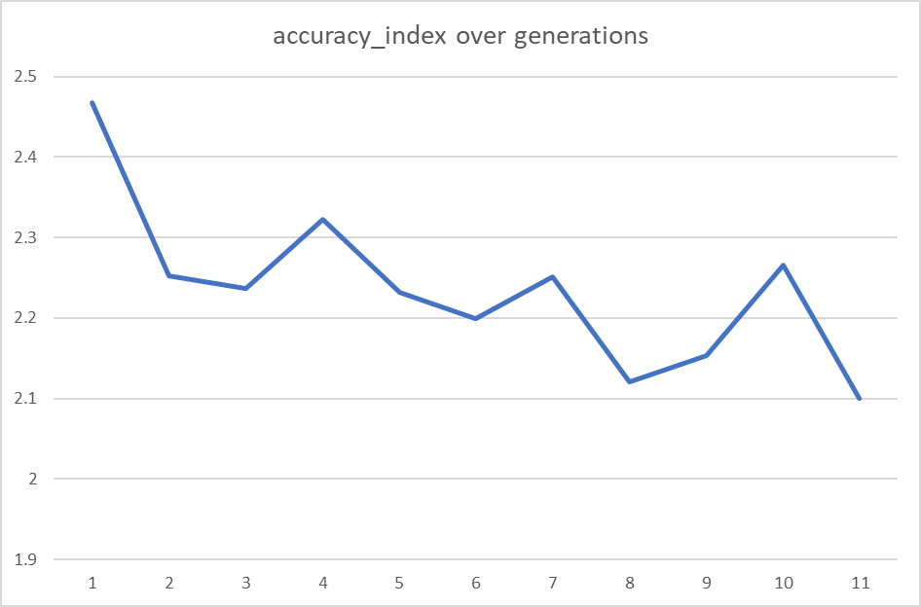
Evaluation of model 2: Goal 2
2016-2018: 2.4674
2016-2018 + first race in 2019: 2.2521
2016-2018 + first 2 races in 2019: 2.2362
2016-2018 + first 3 races in 2019: 2.3220
2016-2018 + first 4 races in 2019: 2.2321
2016-2018 + first 5 races in 2019: 2.1993
2016-2018 + first 6 races in 2019: 2.2518
2016-2018 + first 7 races in 2019: 2.1212
2016-2018 + first 8 races in 2019: 2.1538
2016-2018 + first 9 races in 2019: 2.2651
2016-2019 full seasons: 2.0999
Graph representation of accuracy index over generations
Decreasing trend of accuracy index from the first to the last model
→ Accuracy increases with additional race data
Notes:
For our second evaluation goal, we ran the same set of tests, but in each generation of trained model, we train them with 1 additional race, chronologically added to the training dataset. We have the base model trained from 2016-2018, and add 1 more race in 2019 to the dataset for each generation.
We can see a decreasing trend of accuracy index from the first to the last generation of model, which proves that model accuracy increases with additional race data.

Slide 56
Conclusion of model 2
Performance:
Around ±2.0 error in predicting the final position
Model evaluates pitstop strategy decisions under Safety Car conditions effectively
Proven to be more accurate when fed with more race data in the future
Notes:
To conclude our model 2, it is accurate and reliable, with around 2 absolute error in predicting the final position. More data to be trained would also increase the model accuracy in the future.

Slide 57
Decision support system (DSS)
Notes:
Our last goal is to make a simple decision support system, or DSS.

Slide 58
Decision Support System
A simplified command-line-interface DSS that mimics the functionality
Quickly gather necessary data, and give out prediction results
Short and simple result leads to quick decision making
Notes:
The reason is we need to provide the user a quick way to generate the needed prediction, so to make fast decisions during the race.

Slide 59

Decision Support System
DSS UI, asking which model to be used.
Notes:
Our command line interface DSS would work like this: now it asks the user which model to be used. We choose model 1 first.

Slide 60

Decision Support System
DSS UI, asking which racetrack to be predicted.
Notes:
And which racetrack to be predicted, and some more information gathering question prompts.

Slide 61

Decision Support System
DSS UI, showing model 1 predicted results as 3rd place.
Notes:
At the end, the program will show the predicted final position gain, and the corresponding predicted final position.

Slide 62

Decision Support System
DSS UI, showing model 2 predicted suggestions to go into the pit.
Notes:
For model 2, it generates both pitting in or staying out prediction results, and pick the one with a better result, and suggest it to the user, for example here, the model suggests the driver to pit in now.

Slide 63
Conclusion

Slide 64
Conclusion
Good accuracy:
Around ±2.2 error from final position for Model 1: Pitstop strategy
Around ±2.0 error from final position for Model 2: Accident Scenario
Good accessibility:
DSS functions as expected
Clean, short and simple results are quickly shown
Notes:
To conclude, both ML models reach a good accuracy in predicting the final position of drivers. The DSS functions as expected with a short and simple prediction result shown to users.

Slide 65
Improvement
Inapplicable scenario:
3-stop strategies, or even more stops
Wet weather, or mixed weather conditions
DNF (Did-not-finish) records
Future works
Improve Driver & Team Ability index score
Include confidence score for prediction results
Data visualization & Dynamic DSS
Notes:
For future improvements, we should extend the model to consider 3-stop strategies, and races like wet or mixed weather conditions with wet tyre compounds. We should also improve the driver and team ability index score, and include a confidence score for each prediction results. The DSS could be made more dynamic and with useful data visualization that help user from understanding the predictions.

Slide 66
Thank you
Forza Ferrari! Let’s make Ferrari great again!
Notes:
That is the end of my presentation, thank you! May I know if you have any questions related to the project?

Slide 67
Additional details worth including

Slide 68




Data collection
FIA Official results & statistics
Pit stop tyre strategies
F1 website with additional data
F1 subscription plan live timing data

Slide 69


Fastest Lap
Lap chart

Slide 70


Lap Times
Pit Stop

Slide 71


Total Lap Times
Lap Delta

Slide 72



Laps undercut
Weather
Altitude

Slide 73

Final standing (combined table)

Slide 74

Safety car scenario

Slide 75




All 2019 races
All 2018 races
All 2017 races
All 2016 races

Slide 76

About the model
Supervised machine learning model
Based on 80% historical data, train a model and test on 20% of historical data
Goal: Include from 2014-2019, then use 2020 season as test that reaches 70% accuracy
Reason: Same era (no gas refill, similar tyre options, hybrid engine era)
Notes:
2014-2021: The FIA announced to change the 2.4-litre V8 to 1.6-litre V6 engines for the 2014 season.
https://en.wikipedia.org/wiki/Formula_One_engines#2014%E2%80%932021

Slide 77


What?... Is an undercut & overcut
Undercut strategy

Slide 78

What?... Is an undercut & overcut
Assume car A and B are in between a small gap
Undercut:
Car B enters the pit earlier (e.g. 3 laps earlier)
Car B changes a new set of tyres
Car A uses the old set of tyres to run 3 laps
Car A reacts and pit in 3 laps later
➔ Car B gets ahead of Car A
Overcut:
Car B enters the pit earlier (e.g. 3 laps earlier)
Car B changes a new set of tyres
Car A uses the old set of tyres to run 3 laps
Car A reacts and pit in 3 laps later
➔ Car A gets ahead of Car B

Slide 79
What?... Is an Accident Scenario / Safety Car Scenario
Accident happened due to car crashing, car failure (engine, brake, suspension, power unit, etc.)
Marshall needed to clear the track from blockage, and resume the race ASAP
All cars follow the leading safety car in a relatively slower speed
Going into pit is called a “free pitstop” because it is less costly to spend the time in pitstop than that when it is normally racing
Staying out can be beneficial if the track is hard to overtake, or all drivers have already formed a line behind the safety car

